Slide 1

Cost Optimization and Self-Service Reporting with Generative AI and Google Cloud Logging
This presentation explores a solution that leverages Generative AI and Google Cloud Logging to optimize cloud costs and empower self-service reporting for organizations using Google Cloud Platform (GCP).

Slide 2
The Challenge: Managing Cloud Costs
Manual Analysis
Customized Reporting
Manual analysis of resource utilization and cost trends is time-consuming and error-prone.
Generating customized reports for different stakeholders can be tedious and repetitive.

Slide 3



The Solution: Generative AI and Google Cloud Logging
Ingest Cloud Logging Data
1
Continuously ingest relevant cost-related logs from Google Cloud Logging.
AI-Powered Insights
2
Utilize Generative AI models to analyze the ingested data.
Generate Actionable Recommendations
3
Generate specific and actionable recommendations for cost optimization.

Slide 4
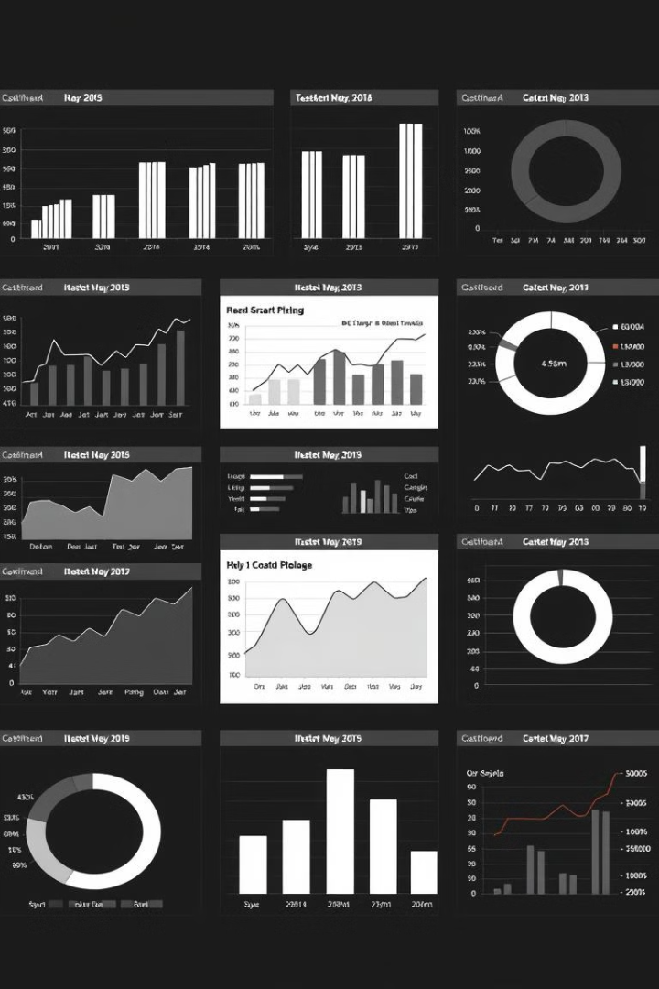
AI-Powered Insights: Unlocking Cost Savings
1
Identify Underutilized Resources
2
Predictive Cost Forecasting
Detect resources with low utilization rates and recommend resizing or shutting them down during off-peak hours.
Forecast future spending based on historical usage patterns and identify potential cost spikes.
3
Anomaly Detection
Flag unusual spending patterns or unexpected resource consumption.

Slide 5
Self-Service Reporting: Empowering Users
Natural Language Interfaces
Automated Report Generation
Enable users to generate custom reports using natural language queries.
Utilize Generative AI to automatically generate reports in various formats.

Slide 6

Benefits: Transforming Cloud Management
Reduced Cloud Costs
Improved Efficiency
Enhanced Visibility
Proactively identify and implement cost-saving measures, leading to significant cost reductions.
Automate repetitive tasks, freeing up IT teams to focus on more strategic initiatives.
Gain deeper insights into cloud spending patterns and identify areas for improvement.

Slide 7




Key Considerations: Ensuring Success
Data Privacy and Security
Model Accuracy and Bias
User Experience
Ensure that sensitive data is handled securely and in compliance with relevant regulations.
Continuously monitor and refine the AI models to ensure accurate and unbiased insights.
Design an intuitive and user-friendly interface for interacting with the AI-powered system.

Slide 8

Conclusion: Embracing the Future of Cloud Management
By leveraging the power of Generative AI and Google Cloud Logging, organizations can gain better control over their cloud costs, make data-driven decisions, and optimize their cloud resources more effectively. This solution empowers organizations to embrace the future of cloud management, driving efficiency, agility, and cost savings.

